Slide 1



ITELEC 3
Final Project in PLATFORM TECHNOLOGIES
BSIT- 3M

Slide 2
Group Members
Bautista, Tiffany Anne Vnyx
Gonda, Daenielle
Icarro, Charisma
Manalili, Jonah
Samia, Jovel
Sia, Ronalyn

Slide 3
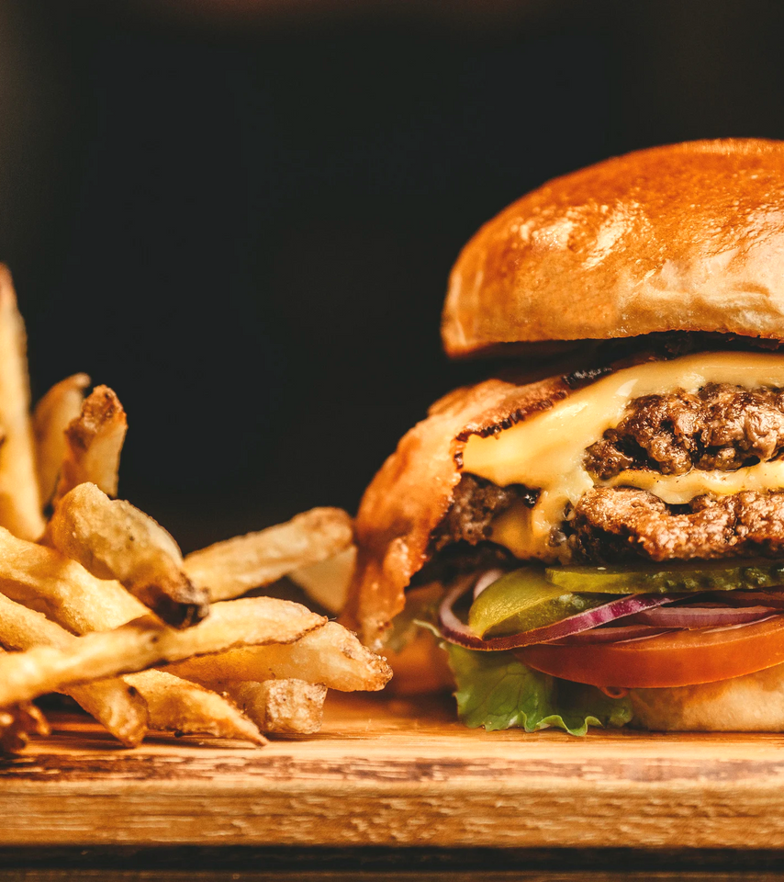
SCREENSHOT/MOCKUPS

Slide 4
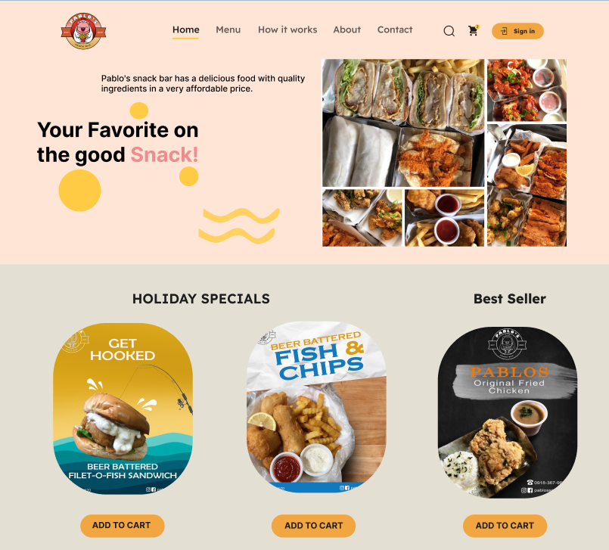

Slide 5
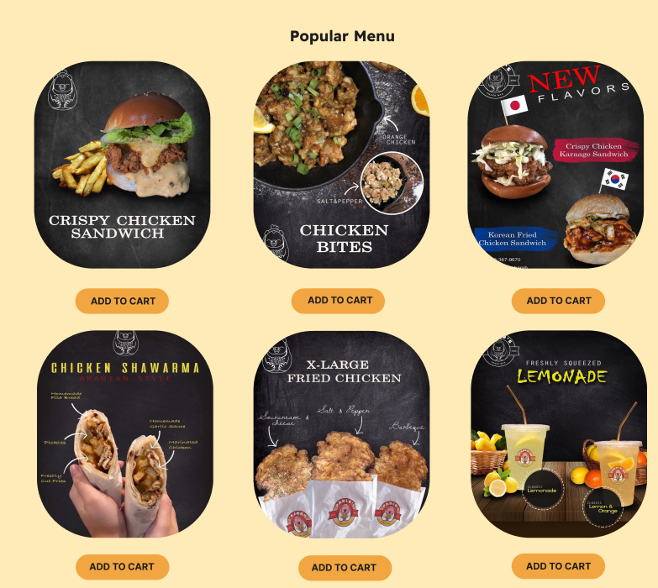

Slide 6
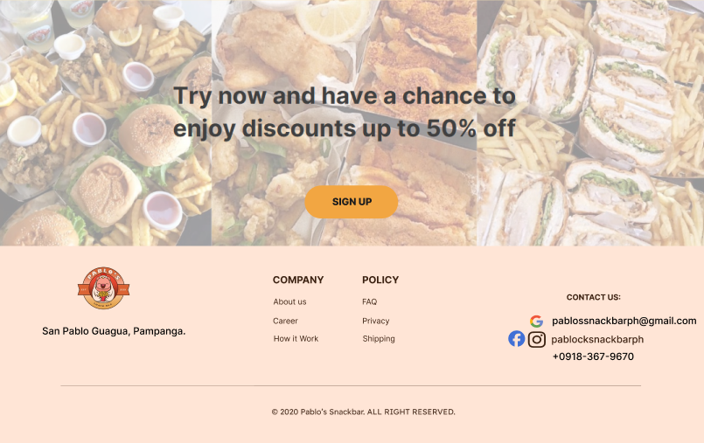

Slide 7
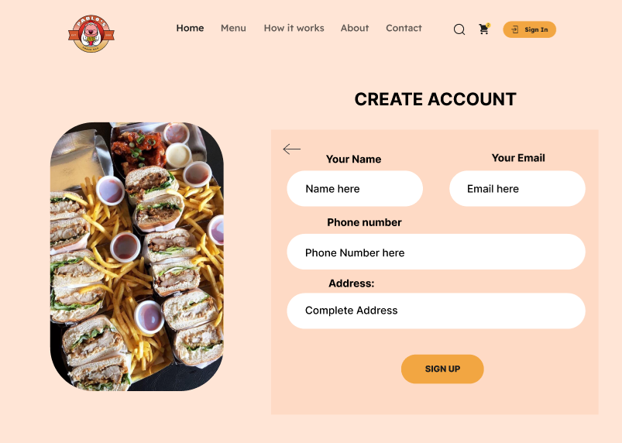

Slide 8
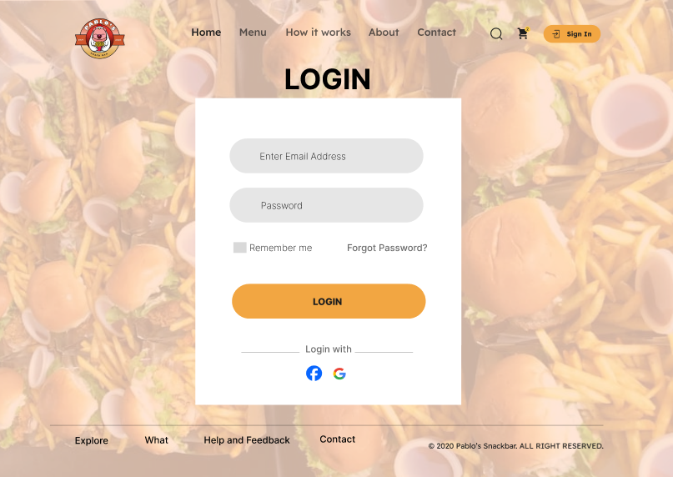

Slide 9
E - COMMERCE PLATFORM

Slide 10


This E- Commerce platform is designed to provide a smooth and enjoyable food shopping experience. The site features an attractive design and user-friendly navigation, making it easy for customers to explore, personalize, and purchase their preferred snacks and meals. It serves both busy individuals and those who prefer to plan their meals at home.

Slide 11
Features:
SPECIAL OFFERS: SECTIONS FOR PROMOTIONS, COMBO DEALS, AND LIMITED-TIME DISCOUNTS.
NAVIGATION BUTTONS DESIGNED TO MAKE NAVIGATION STRAIGHTFORWARD AND USER-FRIENDLY.
ATTRACTIVE DESIGN: A VISUALLY APPEALING LAYOUT TO ENHANCE USER EXPERIENCE.
USER-FRIENDLY NAVIGATION: AN EASY-TO-USE INTERFACE FOR SMOOTH BROWSING AND ORDERING.
HIGHLIGHTED PRODUCTS: SHOWCASES POPULAR, NEW, OR SEASONAL ITEMS WITH APPEALING VISUALS.
CATEGORY LINKS: QUICK ACCESS TO MAIN FOOD CATEGORIES

Slide 12
Interactive Features:
ORDER CUSTOMIZATION: ALLOWS USERS TO PERSONALIZE THEIR MEALS AND SNACKS.
ORDER TRACKING: PROVIDES REAL-TIME UPDATES ON ORDER STATUS.
REVIEWS AND RATINGS: ENABLES CUSTOMERS TO LEAVE FEEDBACK AND READ OTHERS' REVIEWS.
CHAT SUPPORT: OFFERS INSTANT ASSISTANCE FOR ANY QUERIES OR ISSUES.

Slide 13
Target Users:
BUSY INDIVIDUALS: THOSE LOOKING FOR QUICK AND CONVENIENT FOOD OPTIONS.
MEAL PLANNERS: CUSTOMERS WHO PREFER TO PLAN AND ORDER MEALS FROM HOME.

Slide 14

Project Link:
https://www.figma.com/design/QzgnWBjh3XeCPFYCNQW49U/Pablo's-Snackbar?node-id=0-1&p=f&t=fteBToSt4CCFVZ3m-0

